Slide 1
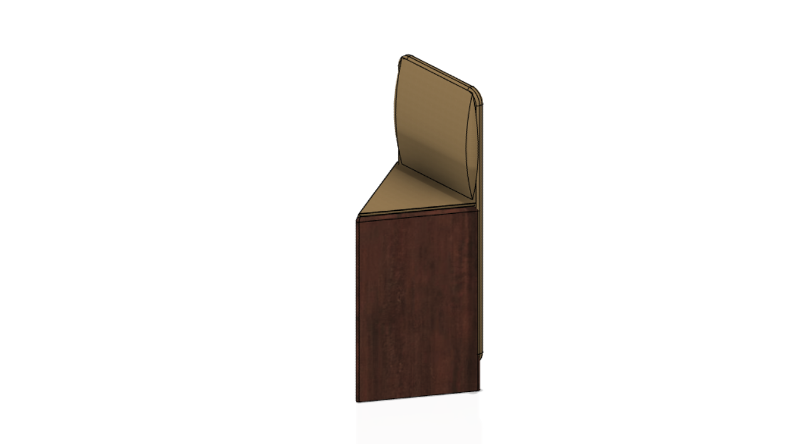
SOMMET
Team – Echo Developers
Members - Aarav Kansara and Siddh Kalolia
Topic – Smart Furniture

Slide 2
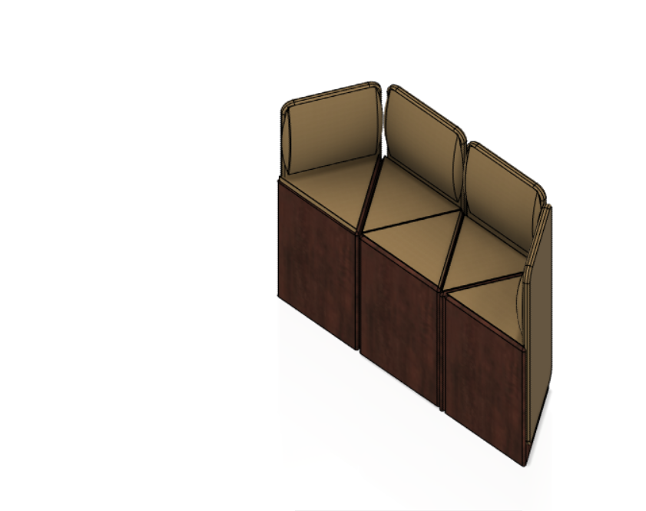
INTRODUCTION
WHAT ARE ELECTROMAGNETIC SOFAS?
We have created sofas that have electromagnets on their sides. The sofa is triangular shaped . Multiple sofas of this type would create a complete sofa , you can easily form sofas with the help of electromagnets mounted on the side .

Slide 3
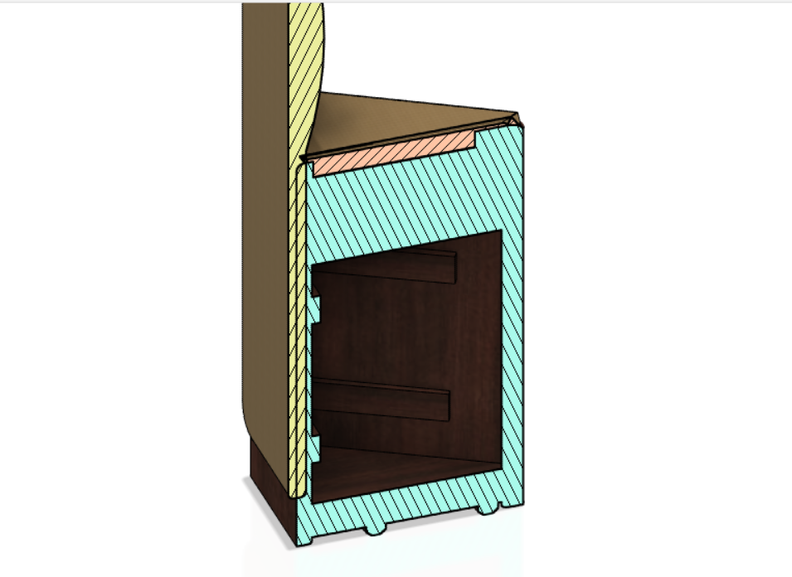

WHY DO YOU NEED THESE SOFAS?
These sofas are specialised to fit in small spaces . These sofas are fitted with electromagnets to ease the process of moving those sofas into their positions.
These sofas have electromagnets. These electromagnets they have many materials that can be changed at any time.

Slide 4
THANK YOU
REGARDS TEAM ECHO
HOPE YOU LIKE IT

